Slide 1
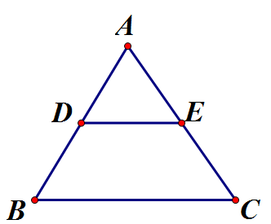


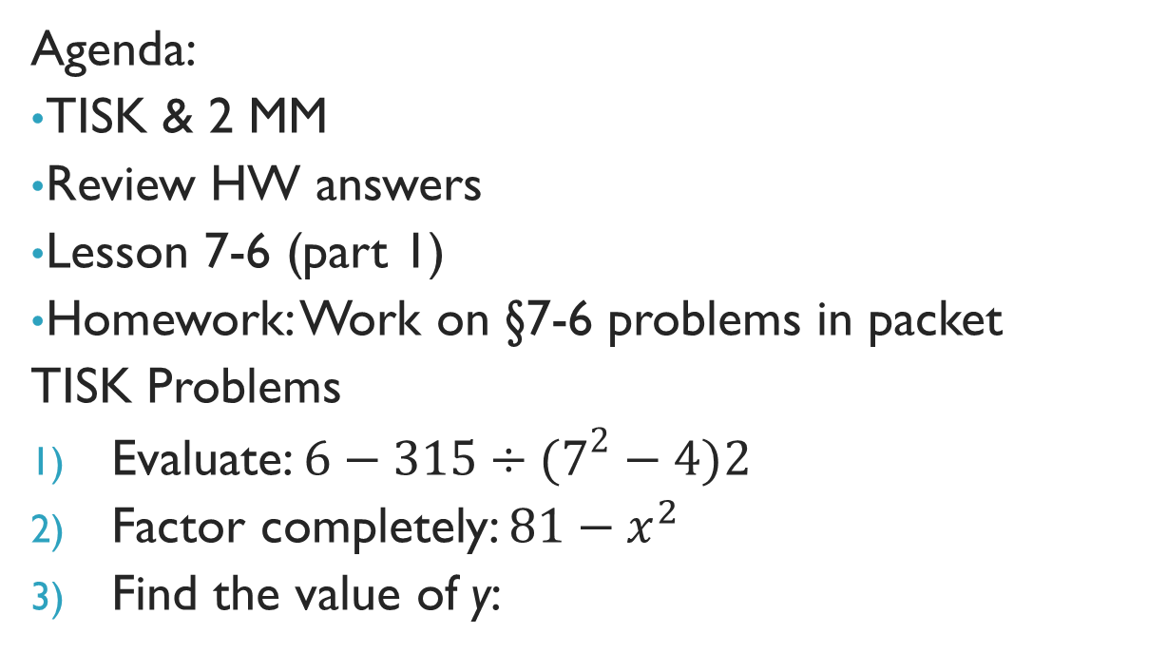
Tuesday, January 22, 2013
Agenda:
TISK & 2 MM
Review HW answers
Lesson 7-6 (part 1)
Homework: Work on §7-6 problems in packet
TISK Problems
Evaluate: $6−315÷(7^{2}−4)2$
Factor completely: $81−x^{2}$
Find the value of y:
$$4y−3$$
$$12y+9$$
Notes:
Mental Math
1.) Start with eight more than the number of years in a century. (108) Divide by the number of sides on a nonagon. (12) Subtract the number of vertices on a pentagon. (7) Multiply by the sum of 1 and 7. (56)
2.) Start with twelve fewer than the number of eggs in a dozen. (0) Divide by the number of sides on a dodecagon. (0) Subtract the number of sides on a hexagon. (-6). Multiply by the difference of 8 and 4. (24)

Slide 2
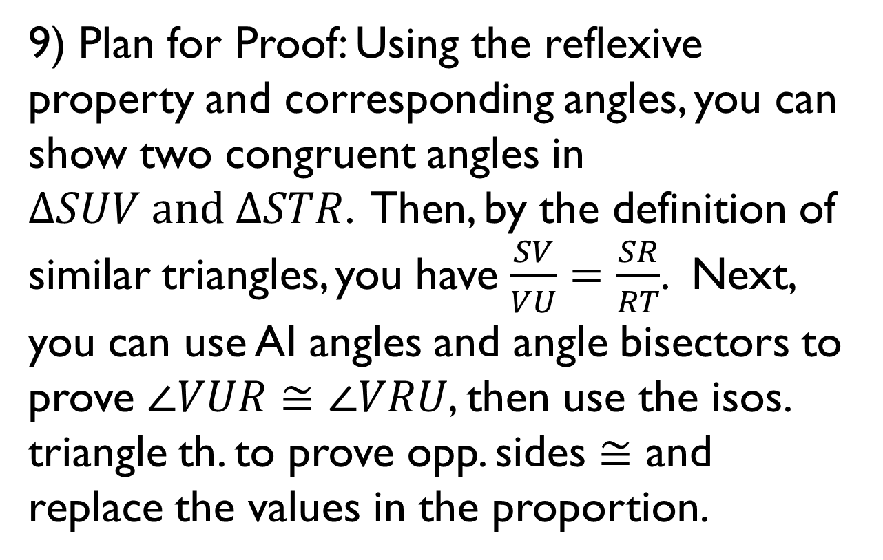
Homework Check
9) Plan for Proof: Using the reflexive property and corresponding angles, you can show two congruent angles in $ΔSUV and ΔSTR$. Then, by the definition of similar triangles, you have $\frac{SV}{VU}=\frac{SR}{RT}$. Next, you can use AI angles and angle bisectors to prove $∠VUR≅∠VRU$, then use the isos. triangle th. to prove opp. sides $≅$ and replace the values in the proportion.

Slide 3
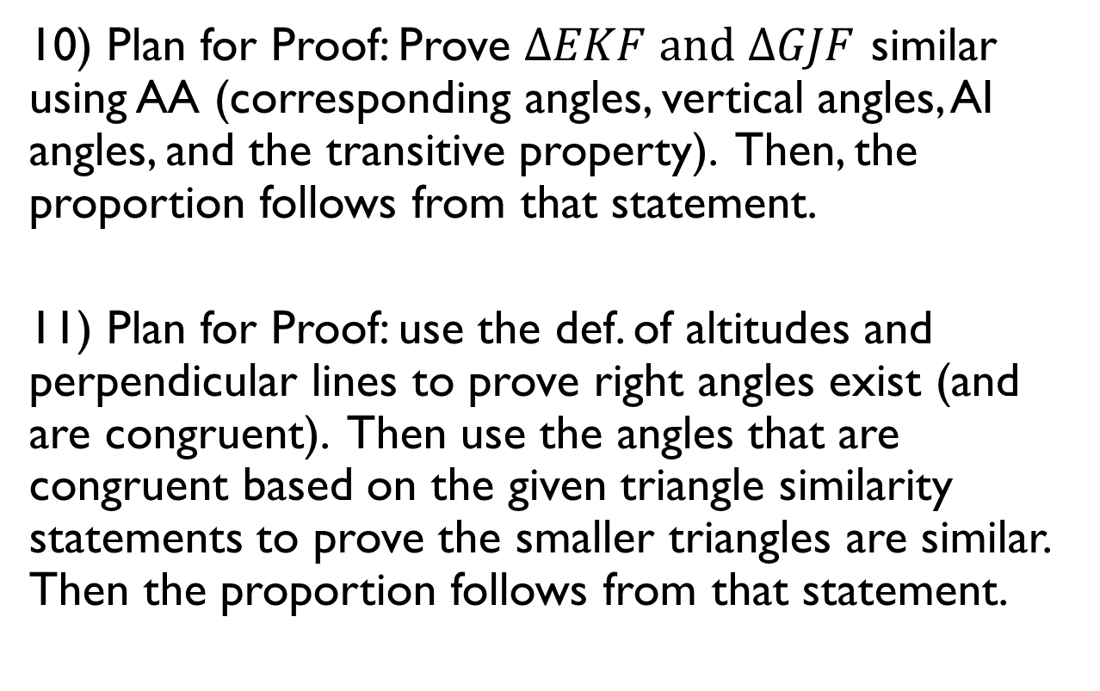
Homework Check
10) Plan for Proof: Prove $ΔEKF and ΔGJF$ similar using AA (corresponding angles, vertical angles, AI angles, and the transitive property). Then, the proportion follows from that statement.
11) Plan for Proof: use the def. of altitudes and perpendicular lines to prove right angles exist (and are congruent). Then use the angles that are congruent based on the given triangle similarity statements to prove the smaller triangles are similar. Then the proportion follows from that statement.

Slide 4
Homework Check
12) Use the reflexive property and the givens to prove the triangles similar. Then the proportion follows from that statement.

Slide 5
§7-6 Fractals & Self-Similarity
Have you ever doodled on the margins of your paper?
Humans are addicted to fractals!

Slide 6

§7-6 Fractals & Self-Similarity
A key to fractals is that they exhibit self-similarity
  A shape is self-similar if smaller and smaller details of the shape have the same geometrical characteristics as the original, larger form.

Slide 7
§7-6 Fractals & Self-Similarity
Sierpinski
  Waclaw Sierpinski
    Polish mathematician
    Created a “Sierpinski triangle” which is a type of fractal shape created using iteration.
  A figure is strictly self-similar if any of its parts, no matter where they are located or what size is selected, contain the same figure as the whole.
    The Sierpinski triangle is strictly self-similar.

Slide 8
§7-6 Fractals & Self-Similarity
Pascal
  Blaise Pascal
  a French mathematician, physicist, inventor, writer and Christian philosopher
  Created Pascal’s Triangle:
    The first number in the initial row is 1.
    The number in each successive row is the sum of the two numbers above it.
How can you find the sum of the values in the tenth row?
Sums
1
= 1
r₁
= 2⁰
r₂
1 1
= 2
= 2¹
= 4
r₃
1 2 1
= 2²
= 8
r₄
1 3 3 1
= 2³
r₁₀
= 2¹⁰⁻¹
= 2⁹
= 512

Slide 9
§7-6 Fractals & Self-Similarity
Koch
  Helge Von Koch
  Swedish Mathematician
  Created the Koch Snowflake:

Slide 10
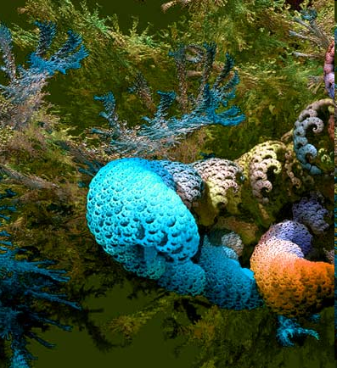
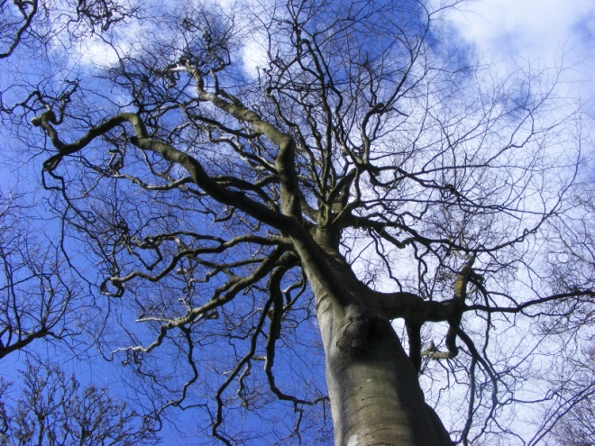
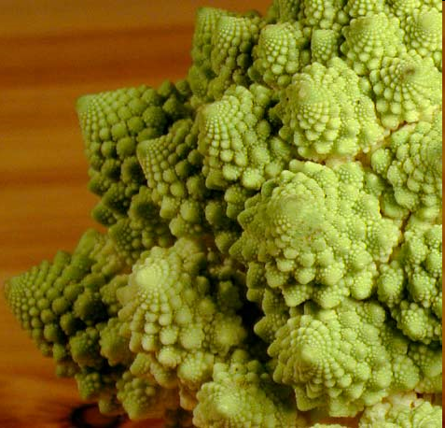
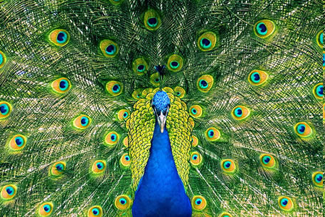
§7-6 Fractals & Self-Similarity
Mandelbrot
  Benoit Mandelbrot
  Polish-born, French and American Mathematician
    Did the most to formalize study of fractals
    Dr. Mandelbrot felt that “pure” mathematics was too strict to describe real phenomena in nature.
    “Clouds are not spheres, mountains are not cones, coastlines are not circles, bark is not smooth, and lightning does not travel in a straight line.” – Benoit Mandelbrot
    By using fractals, he was able to show much more natural shapes!

Slide 11
§7-6 Fractals & Self-Similarity
Another look into why fractals are just so cool…
  http://www.youtube.com/watch?v=DK5Z709J2eo&list=PLF7CBA45AEBAD18B8

Slide 12
§7-6 Fractals & Self-Similarity
Make your own!
  Start with a single geometric shape (pentagon, square, rectangle, kite, triangle, etc.).
  Modify it along one edge in some way.
  Repeat the modification along each edge.
  Continue making smaller versions of this shape using similarity rules to guide your placements.
  Name your figure.

